Slide 1


Organic Pharmaceutical Chemistry
Fourth Stage First Semester
Lab No: 3
Assay
of Aspirin

Slide 2
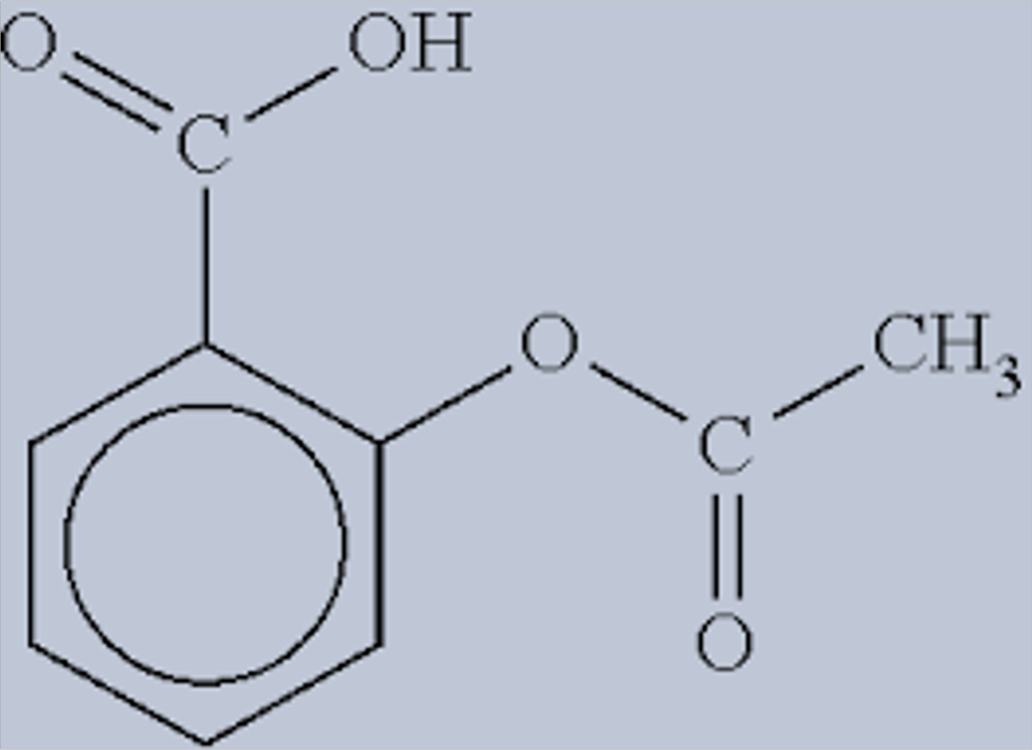
Aspirin
•
Aspirin is a weak acid
•
Direct titration
HA (aq) + NaOH (aq) H2O (l) + NaA (aq)
Acid base salt

Slide 3
Direct titration
•
Titrant
(in burette)
analyte

Slide 4
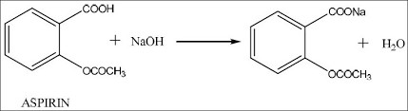
•
Assuming that there is no other acids with aspirin, the titration with NaOH
allows you to determine the amount of the aspirin in the tested tablet.
However this is not the
Case ?!
•

Slide 5
Back titration
•
In this experiment, back titration
method will be used in
order to determine the weight of aspirin in a typical aspirin
Tablet?
•
Each aspirin molecule reacts
with
two sodium hydroxide molecules

Slide 6
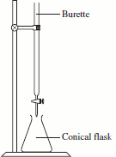
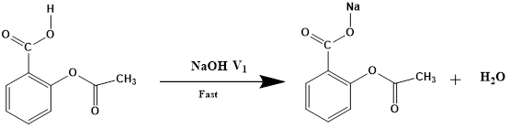
Principle
1-
Masking
the
carboxyl
groups
by
titration
of
aspirin
with
0.1M
NaOH(V1)
0.1M
NaOH
(V1)
Aspirin
dissolved
in ethanol

Slide 7
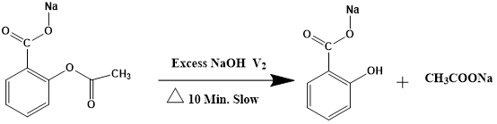
2.
Alkaline
hydrolysis
of
aspirin
ester
using
excess
0.1M
NaOH
(V2)
Excess of
0.1M
NaOH(V2)
Aspirin+
V1 NaOH
In theory, V2 is equil to V1, since one mole
of aspirin is made from one mole of
salicylic
acid( masked by V1 NaOH) and one mole of acetic acid neutralized by V2 NaOH
The break down of aspirin requires an excess of base to ensure the complete hydrolysis
Furthermore, aspirin tablet may contain carboxyl groups that are not related to the
structure of the acetyl salicylic acid

Slide 8
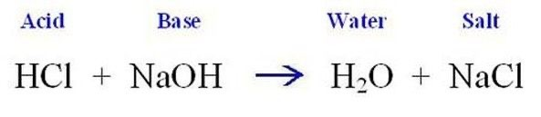
3.
Back
titration
of
the
unconsumed
0.1M
NaOH
(V3)
with
0.1M HCl
0.1M HCl
Excess of 0.1M
NaOH(V2)

Slide 9
Procedure and calculation
1. Triturate one tablet of commercially available aspirin(SDI), and place it into a conical flask
2. Dissolve the triturated aspirin with 10ml ethanol. The solution will remain cloudy due to the insoluble
additives
3. Add one drop of phenol red indicator (yellow)
4. Slowly titrate the aspirin with the standardized 0.1M NaOH solution drop by drop until the endpoint is
reached, (V1). (purple)
5. Add excess of NaOH (V2). (V2= V1 + 3 ml)
6. Heat the mixture for ten minutes with stirring
7. Back titration with 0.1M Hcl ( V3). V3 is the remaining base(unconsumed, not reacted with the aspirin) color disappeared
8. Consumed NaOH (V4) = V2 – V3
9. Moles (consumed NaOH )= Moles ( aspirin)
10. Wt (aspirin) ?/ M.Wt (aspirin) = V4 (consumed NaOH) × Molarity (consumed NaOH)

Slide 10

